Slide 1
Operating system BIT253CO
By: Er Suvash Chandra Gautam
(System Development and Implementation Expert, NBCC-JICA)

Slide 2
AGENDA
Teaching schedule Hours/Week |  |  | Examination Scheme
Theory | Tutorial | Practical | Internal Assessment |  | Final |  | Total
3 | 1 | 2 | Theory | Practical | Theory | Practical | 150
 |  |  | 20 | 50 | 80 | -

Slide 3
LIST OF TASK
ASSIGNMENT
LAB REPORT
PRESENTATION
LEARNING RESOURCE MATERIAL(TEXTBOOKS, REFERENCES BOOKS AND BOOKS SPECIFY IN YOUR SYLLABUS)
CASE STUDY OR FIELD VISIT (DEPENDING UPON THE SITUATION)
DISCUSSION, INTERACTION IN CLASSROOM, GUEST LECTURER

Slide 4
assignment
ASSIGNMENT- 9 CHAPTER -9 ASSIGNMENT- EACH CHAPTER HAS ONE ASSIGNMENT HAVING 10 QUESTIONS
SUBMIT THEM IN PRINTED FORMAT WITH PROVIDED GUIDELINES.
USE A4 SIZE PAPER TO PERFORM YOUR ASSIGNMENT, CASE STUDY AND OTHER SUGGESTED WORK.
THE COVER PAGE FORMAT WILL BE PROVIDED/UPLOADED IN GOOGLE DRIVE TO EASY ACCESS.

Slide 5
LAB REPORT
WE WILL PERFORM 10 NUMBERS OF LAB REPORT
PRINT YOUR LAB REPORT AFTER YOU OBSERVED AND TESTED IN YOUR LAB.
THE SAMPLE LAB REPORT WILL BE PROVIDED FOR YOUR REFERENCES.
DO NOT COPY IT FROM OTHERS STUDENTS, IF FOUND WILL NOT BE ACCEPTED, MEANS AUTOMATICALLY REJECTED

Slide 6
PRESENTATION
PRESENTATION TOPIC WILL BE ASSIGNED AT THE BEGINNING SESSION OF THE SEMESTER MAKING GROUP.
FOUR STUDENTS=1 GROUP
PREPARE THE PRESENTATION BY DISCUSSING WITH EACH STUDENT IN YOUR GROUP. YOU CAN USE RESEARCH PAPER, BOOKS, REFERENCES BOOKS, WEB PORTAL FOR YOUR CITATIONS.
ONCE YOU PREPARE, UPLOAD IT IN THE GOOGLE DRIVE.

Slide 7
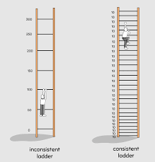
HOW TO SUCCESS IN EXAM

Slide 8
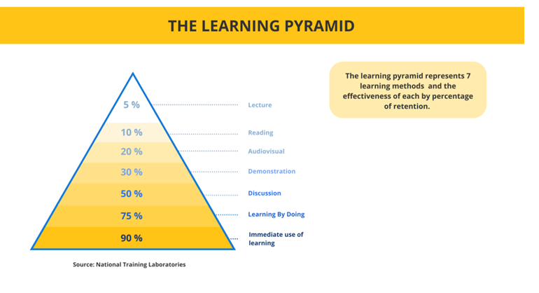

The learning pyramid

Slide 9
What is an Operating System?
An operating system (OS) is system software that manages computer hardware and software resources, and provides common services for computer programs.
Provide the interface between the user and machine/hardware.
Example: Microsoft Windows
Created by Microsoft in mid-1980s
Notable Versions: Windows 10 (2015), Windows 8 (2012), Windows 7 (2009)
Windows Vista (2007)
Pre-loaded on most new PCs
Most popular OS globally

Slide 10
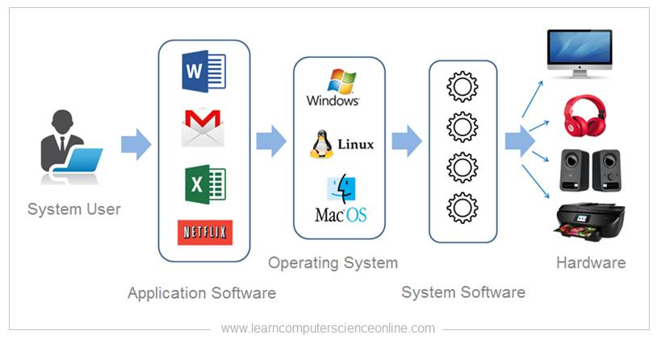

Slide 11
What is an Operating System?
A program that acts as an intermediary between a user of a computer and the computer hardware
Operating system goals:
Execute user programs and make solving user problems easier
Make the computer system convenient to use
Use the computer hardware in an efficient manner
Primary Goal: Convenience( Easiest way to access hardware), 95% of market is cover by Microsoft.
Market Acquisition of Windows in 2018: 82%

Slide 12
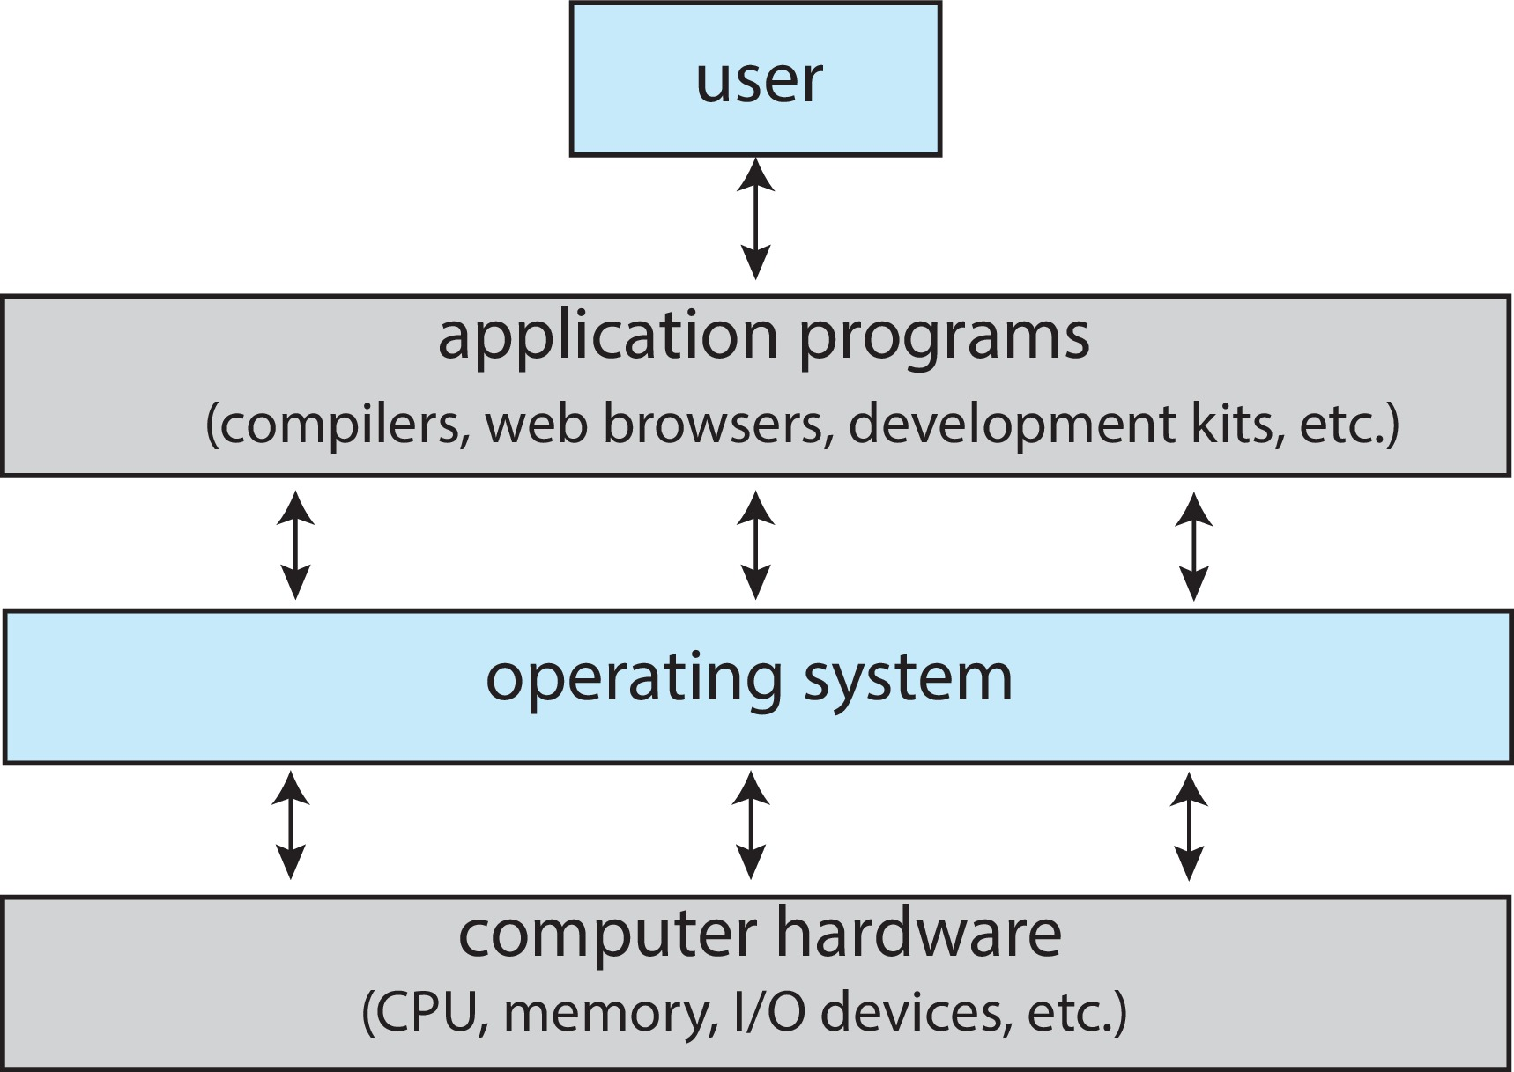
Abstract View of Components of Computer

Slide 13
Computer System Structure
Computer system can be divided into four components:
Hardware – provides basic computing resources
CPU, memory, I/O devices
Operating system
Controls and coordinates use of hardware among various applications and users
Application programs – define the ways in which the system resources are used to solve the computing problems of the users
Word processors, compilers, web browsers, database systems, video games
Users
People, machines, other computers

Slide 14
Examples of Operating System
Linux (Open-Source OS)
Family of open-source operating systems
Free
Various customizable distributions
Global Usage:
Linux users<2%
Widely used in servers

Slide 15
Examples of Operating System
Operating Systems for Mobile Devices
Mobile Devices:
Phones, tablets, MP3 players
Specialized OS:
Designed for mobile devices
Examples:
Apple iOS (Stable Performance, Enhanced Security, & Warranty Purposes)
Google Android( Most Popular OS based on the number of devices installed)
Primary Used: Mobile devices/Smartphone and tablets.

Slide 16
Examples of Operating System
Android Operating System
Developed by Android Inc., acquired by Google in 2005.
Open-source OS for mobile devices.
Built on a modified Linux kernel.
Dominates over 70% of the global mobile OS market.
Powers billions of devices worldwide.

Slide 17
Smartphone Sales
79.0% Android
14.2% IOS
3.3% Windows
2.7 Blackberry
0.9 Others

Slide 18
OPERATING SYSTEM AS A RESOURCE MANAGER
An operating system, at its core, functions as a resource manager. Its primary role is to efficiently allocate and manage the various hardware and software resources of a computer system to ensure that tasks and processes run smoothly.
Resource Management: It refers to how to manage resources efficiently between different processes.
Two types of Resources:
Hardware Resources[IMP]:
PROCESSOR, MEMORY, I/O devices

Slide 19
HARDWARE RESOURCES
Here are some of the key resources managed by an operating system:
Processor (CPU): The CPU is one of the most critical resources in a computer. The OS schedules tasks to be executed by the CPU, ensuring that multiple processes can run concurrently.
Memory (RAM): The OS is responsible for managing the allocation and deallocation of memory space for processes. It ensures that each program gets the memory it needs without interfering with others.
Input/Output Devices: This includes devices like keyboards, mice, displays, printers, etc. The OS manages the flow of data between these devices and the programs that use them.

Slide 20
HARDWARE RESOURCES
Resource Allocation
Process of assigning available resources to processes.
Can be dynamic or static.
Resource
Anything assignable in the OS (e.g., CPU time, memory, disk space).
Resource Management
Efficient allocation of resources among processes.
Process
Executing program with own memory, state, and resources.

Slide 21
HARDWARE RESOURCES
Scheduling
Determining which process gets a resource at a given time.
Deadlock
Processes waiting for resources, causing a standstill.
Semaphore
Prevents race conditions; synchronizes processes.
Mutual Exclusion
Ensures only one process accesses a resource at a time.

Slide 22
Examples of Operating System
UNIX Operating System
Developed in the early 1970s at Bell Labs.
Known for stability, security, and scalability.
Features include multi-user support, modular design, hierarchical file system, networking capabilities, and robust security.
Variants include System V, BSD, Linux, AIX, HP-UX, and Solaris.
Widely used in servers, development environments, and embedded systems.
Continues to be influential in modern computing.

Slide 23
Functions of Operating System
Process Management
Definition: Supervises processes (programs in execution), allocates resources, and schedules tasks.
Example: When you run multiple applications on your computer (e.g., a web browser, a word processor, and a music player), the OS manages the execution and resource allocation for each process.
Memory Management
Definition: Manages computer memory, allocating space for processes and ensuring efficient utilization.
Example: When you open a program, the OS allocates a portion of RAM for it. If you open more programs, the OS allocates and manages memory dynamically.

Slide 24
Functions of Operating System
File System Management
Definition: Organizes and manages files on storage devices, including creation, deletion, retrieval, and access control.
Example: Creating folders, moving files, and setting permissions on files or directories are all file system management functions.
Device Management
Definition: Controls and coordinates input and output devices (e.g., keyboard, mouse, printer).
Example: When you print a document, the OS interacts with the printer driver to manage the printing process.

Slide 25
Functions of Operating System
User Interface
Definition: Provides a user-friendly interface for interaction between the user and the computer.
Example: Graphical User Interface (GUI) elements like windows, icons, menus, and pointers (WIMP) in systems like Windows, macOS, and Linux with GUIs.
Security and Access Control
Definition: Ensures that unauthorized users do not access sensitive data or misuse system resources.
Example: User accounts with different privileges (admin, regular user) and password protection.

Slide 26
Functions of Operating System
Networking
Definition: Facilitates communication between different devices on a network.
Example: Connecting to the internet, accessing shared files on a network, or using remote desktop applications.
Error Detection and Handling
Definition: Detects and handles errors that occur during system operation.
Example: If an application crashes, the OS provides an error message and may attempt to recover gracefully.

Slide 27
Functions of Operating System
Resource Allocation
Definition: Distributes resources (CPU time, memory, etc.) among processes based on priority and demand.
Example: If multiple programs are running, the OS decides how much CPU time each program gets to ensure fairness.
Scheduling
Definition: Orders the execution of processes to optimize system performance.
Example: The OS uses scheduling algorithms to determine which process gets the CPU next, aiming to maximize efficiency.

Slide 28
TYPES OF OS
1. Batch Operating System
In the 1970s, Batch processing was a popular computing technique.
Similar types of jobs were grouped together and executed in batches.
Mainframes were the standard single computer used for this purpose.
Definition: System where multiple users submit their jobs for execution.
Users access the system and submit their jobs to the queue.

Slide 29
Batch Operating System
Job Execution in Batch System
Users Submit Jobs:
Multiple users submit their respective jobs to the system.
Queue Management:
The system organizes the jobs in a queue based on first-come, first-served.
Sequential Execution:
Jobs are executed one by one in the order they were received.
Output Collection:
Users collect their respective output once all jobs are executed.

Slide 30
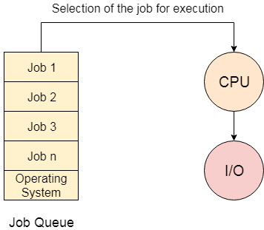
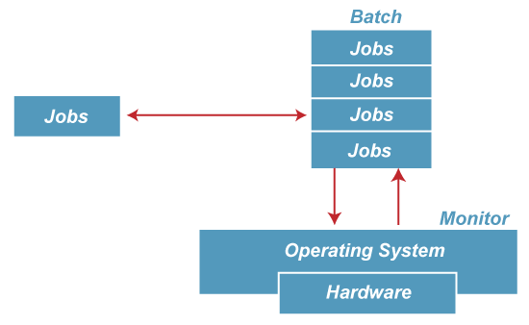
Batch Operating System

Slide 31
Multiprogramming OS
There exist a multiple no of processes in RAM/Primary Memory.
"Multiprogramming is an extension to batch processing.“
Each process needs two types of system time: CPU time and IO time.
"Ensures constant CPU utilization.“
Goal of Multiprogramming "Keep the CPU busy at all times."
Multiprogramming-Non Preemptive OS(type of operating system in which a running process continues to execute until it voluntarily relinquishes control of the CPU (Central Processing Unit) or terminates). If CPU will execute a process, then it will execute it completely unless and until process will say on its own that it want to go for some I/O operation.

Slide 32
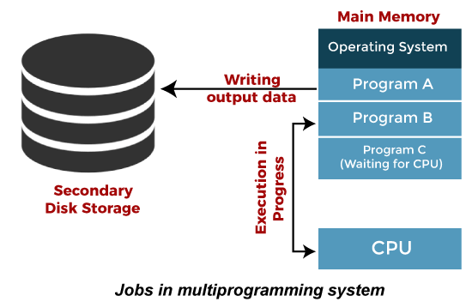
Jobs in Multiprogramming System

Slide 33
Multitasking/Timesharing OS
The multitasking operating system is a logical extension of a multiprogramming system that enables multiple programs simultaneously.
It allows a user to perform more than one computer task at the same time.
A preemptive operating system, also known as a preemptive multitasking system, is a type of operating system that can suspend or interrupt a currently executing process in order to start or resume another, higher-priority task.
CPU time is shared different processes. So, it is called as time sharing system. Time slice is defined by the operating system for sharing CPU TIME BETWEEN PROCESSES.
Advantages: Responsiveness

Slide 34
Multitasking/Timesharing OS
In a preemptive system, the operating system has a scheduler that determines which process should be given access to the CPU and for how long. This decision is based on various factors, such as priority levels assigned to processes, time quantum allocated for each process, and other scheduling algorithms.

Slide 35
Multitasking/Timesharing OS
Time-Sharing: The CPU time is shared among multiple processes, allowing them to execute concurrently.
Priority-Based Scheduling: Processes are assigned priority levels, and the scheduler ensures that higher-priority processes get preference in CPU allocation.
Fairness and Responsiveness: Preemptive systems are more responsive to external events and can quickly switch to handle high-priority tasks.
Multitasking: Multiple tasks can appear to be running simultaneously, even on a single-core CPU.
Isolation of Processes: Preemptive systems ensure that a misbehaving or stalled process doesn't hang the entire system.
Complexity: Implementing a preemptive system is more complex compared to a non-preemptive system due to the need for task scheduling and context switching.

Slide 36
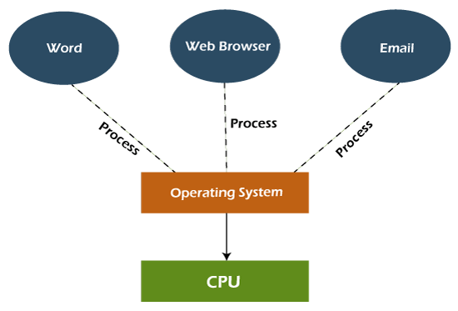
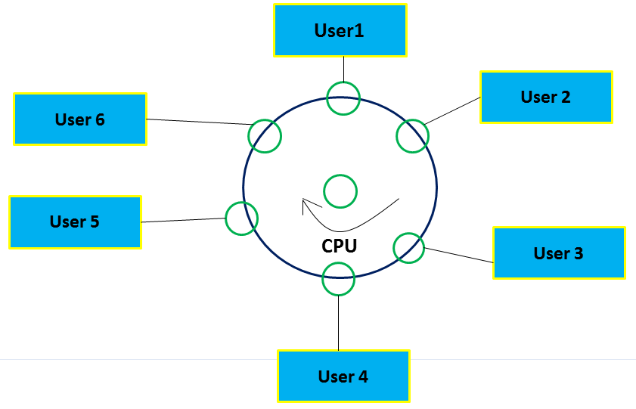
Multitasking/Timesharing OS

Slide 37
Realtime operating system
A Real-Time Operating System (RTOS) is an operating system that guarantees a certain capability within a specified time constraint.
Characteristics of RTOS
Deterministic behavior
Predictable response times
Priority scheduling
Efficient task management

Slide 38
Realtime operating system
Applications:
Embedded Systems
Definition: Specialized computing systems embedded within larger systems or products.
Importance: RTOS ensures precise timing and reliability in devices like microcontrollers, IoT devices, and industrial controllers.
Aerospace and Defense
Definition: Systems used in aircraft, satellites, and military applications.
Importance: Critical for tasks like navigation, guidance, and control systems where split-second decisions are vital.

Slide 39
Realtime operating system
Industrial Automation
Definition: Systems controlling manufacturing processes and machinery.
Importance: Ensures synchronized operation of machines, enhancing efficiency and safety in factories.
Automotive Control Systems
Definition: Systems controlling various aspects of vehicles, from engine control units to safety systems.
Importance: Enables real-time responses for functions like ABS, airbag deployment, and engine management.

Slide 40
Realtime operating system
Medical Devices
Definition: Devices used for patient monitoring, diagnostics, and treatment.
Importance: Critical for tasks like real-time monitoring of vital signs and precise drug delivery.
Consumer Electronics
Definition: Everyday electronic devices like smartphones, digital cameras, and smart TVs.
Importance: Enhances user experience by ensuring smooth multitasking and responsiveness.

Slide 41
Types of rtos
1. Hard Real-Time Operating System
Definition: Systems where missing a deadline can have catastrophic consequences.["Catastrophic consequences" refers to extremely severe or disastrous outcomes that result from a particular event or situation.]
Example: Automotive airbag systems, avionics control.
2. Soft Real-Time Operating System
Definition: Systems where occasional missed deadlines are acceptable but not desirable.
Example: Multimedia applications, video streaming.

Slide 42
Types of rtos
3. Firm Real-Time Operating System
Definition: Systems where missing a deadline can lead to a degraded performance, but it's not catastrophic.
Example: Online gaming, live audio processing.

Slide 43
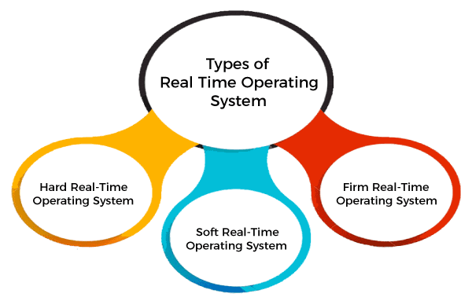
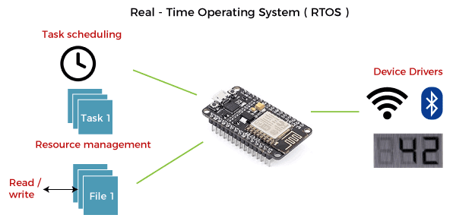
Types of rtos

Slide 44
Networking os
An Operating system, which includes software and associated protocols to communicate with other computers via a network conveniently and cost-effectively, is called Network Operating System.
Advantages of Network Operating System
In this type of operating system, network traffic reduces due to the division between clients and the server.
This type of system is less expensive to set up and maintain.

Slide 45
Networking os
Disadvantages of Network Operating System
In this type of operating system, the failure of any node in a system affects the whole system.
Security and performance are important issues. So trained network administrators are required for network administration.

Slide 46
Distributed operating system
Definition of Distributed Operating System
A Distributed Operating System (DOS) is an operating system that runs on multiple machines and allows them to work together as a single system.
Characteristics of Distributed Operating Systems
Concurrency: Multiple tasks can execute simultaneously.
Transparency: Users perceive the system as a single, unified entity.
Scalability: Ability to handle an increasing number of users and tasks.
Fault Tolerance: System continues to operate in the presence of failures.

Slide 47
Advantages of dos
Resource Utilization
Efficient use of resources across multiple machines.
Example: In a cloud computing environment, virtual machines share physical resources dynamically.
Reliability and Fault Tolerance
Enhanced system reliability as tasks can be distributed and continue even if some machines fail.
Example: Google's infrastructure ensures uninterrupted access to services like Gmail even during server failures.

Slide 48
Advantages of dos
3. Performance Improvement
Parallel processing leads to faster execution of tasks.
Example: Distributed computing clusters like Hadoop allow for the processing of large datasets in less time.

Slide 49
Structure of operating system
What is a System Structure for an Operating System?
Because operating systems have complex structures, we want a structure that is easy to understand so that we can adapt an operating system to meet our specific needs. Similar to how we break down larger problems into smaller, more manageable subproblems, building an operating system in pieces is simpler. The operating system is a component of every segment. The strategy for integrating different operating system components within the kernel can be thought of as an operating system structure. As will be discussed below, various types of structures are used to implement operating systems.

Slide 50
Structure of operating system
Simple/Monolithic Structure
Micro-kernel Structure
Hybrid-Kernel Structure
Exo-Kernel Structure
Virtual Machine(Hypervisor)

Slide 51
Simple/Monolithic Structure/kernel
The monolithic operating system controls all aspects of the operating system's operation, including file management, memory management, device management, and operational operations.

Slide 52
